Slide 1
6G Upper Midband Technology- Near-field Communication
RIT
EEEE.789
Shima Mashhadi
Jan 2025

Slide 2
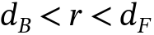
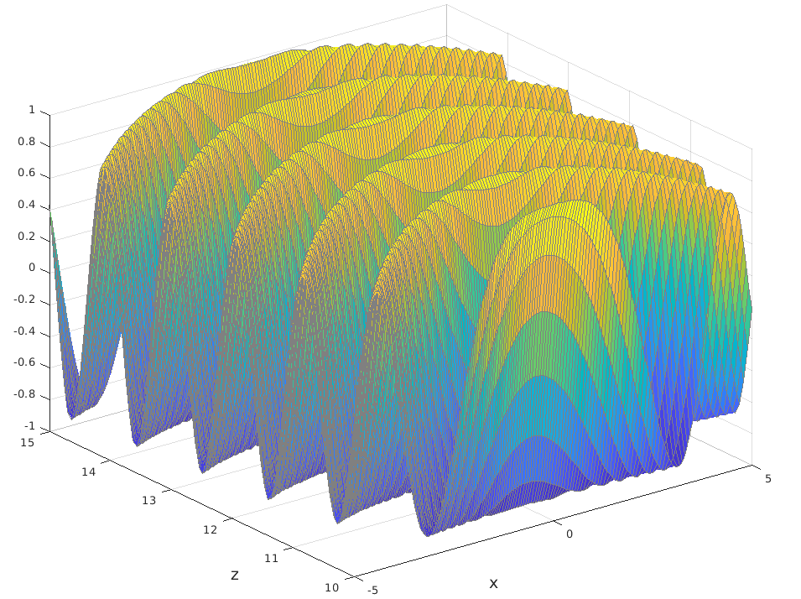
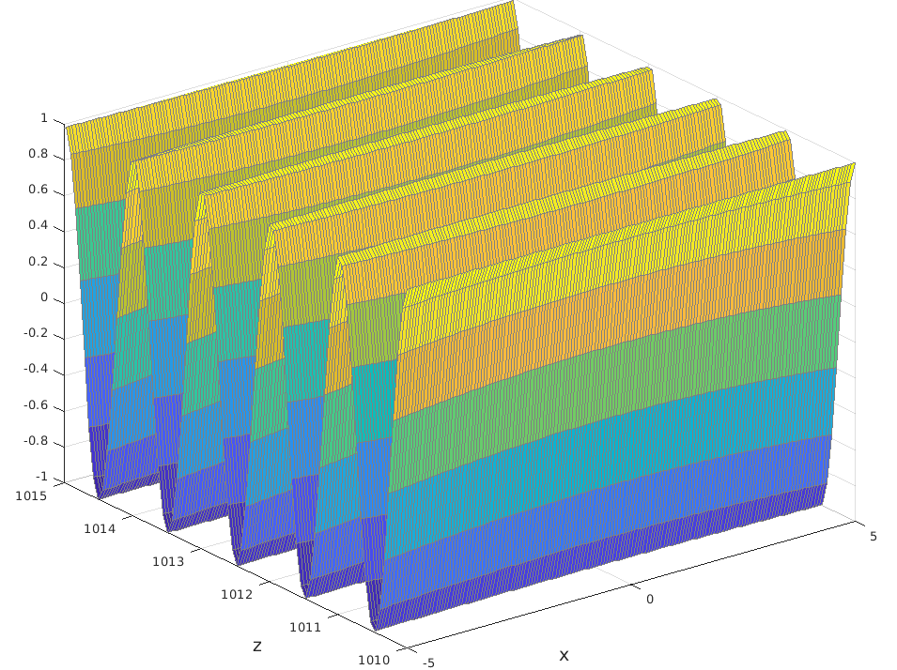
RIT
Nearfield of the Antenna Array
Fresnel region is characterized by the fact that the amplitude variations can be neglected, but not the phase variations.
Curved wavefront
Planar wavefront
Example : Fraunhofer distance
0.5×0.5, 3 GHz = 10 m
1×1 m, 15 GHz = 200m
1×1 m, 30 GHz = 400 m
6G in the Upper Mid-Band: The Rise of Gigantic MIMO - YouTube

Slide 3
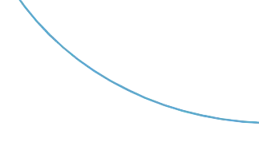
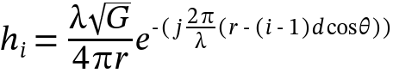
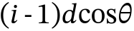
RIT
What is Beamforming ?
Considering a simple SIMO
Transmitter in the far-field
d

Slide 4
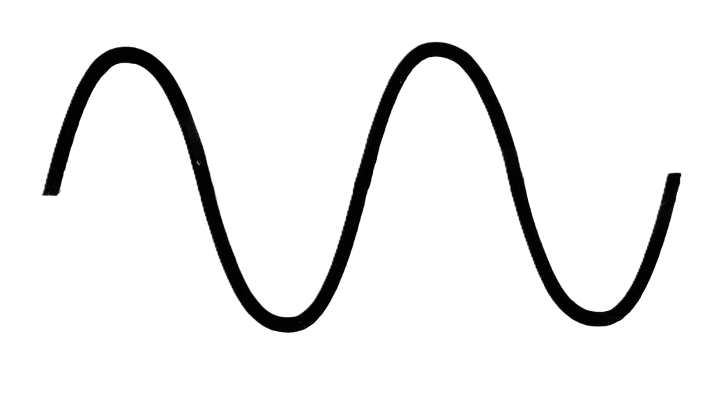
RIT
What is Beam Forming ?
d

Slide 5
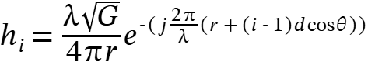
RIT
What is Beam Forming ?
d
What is Beamforming? ("the best explanation I’ve ever heard") - YouTube

Slide 6
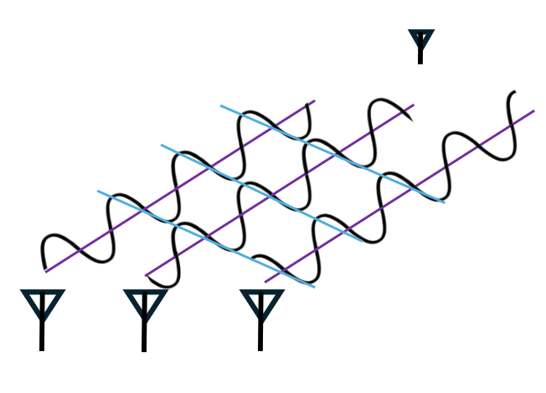
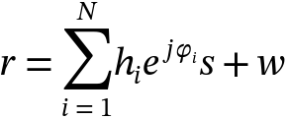
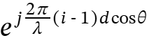
RIT
What is Beam Forming ?
Receiver
The received signal become M times larger
Achievable in LOS
What is Beamforming? ("the best explanation I’ve ever heard") - YouTube

Slide 7
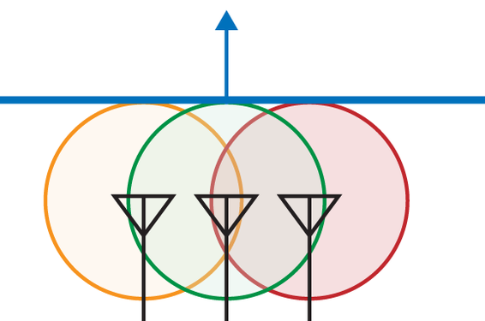
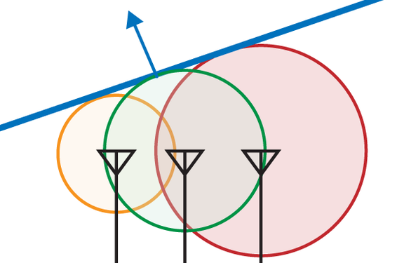


RIT
What is Beam Forming ?
Antennas transmit the signal with the phase-shift
Transmitter
Send the radio energy preferentially in one direction
https://www.oreilly.com/library/view/80211ac-a-survival/9781449357702/ch04.html
Basics of Antennas and Beamforming - YouTube

Slide 8
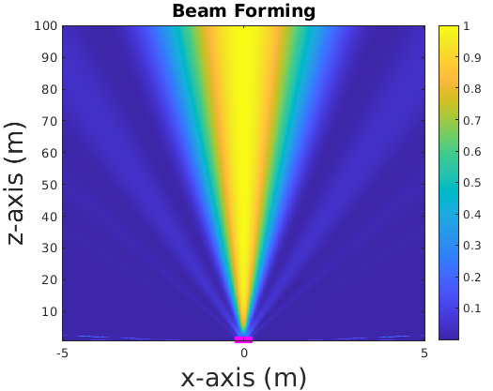
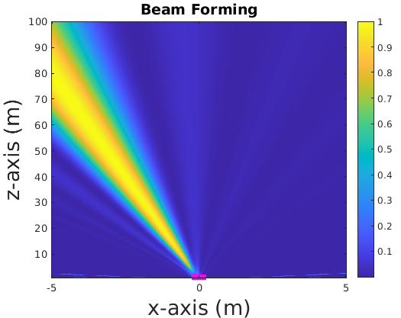
RIT
What is Beam Forming ?

Slide 9
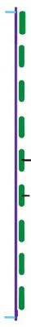

RIT
What is Beam Forming ?
What is the best thing we can do in the far-field?
Multi-user MIMO (MU-MIMO)

Slide 10


RIT
Beampattern in the Near-Field
How about the shape of the beam in the Near-field?

Slide 11
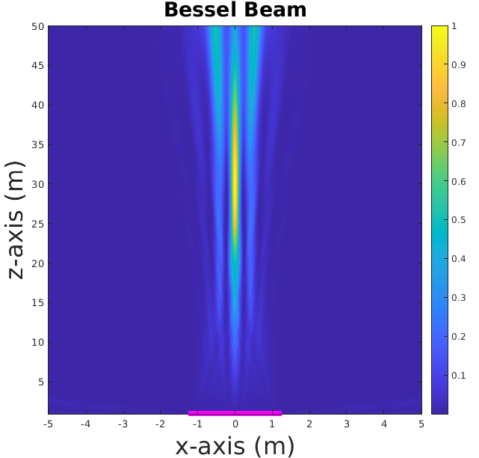
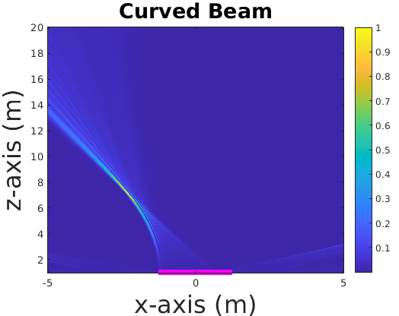
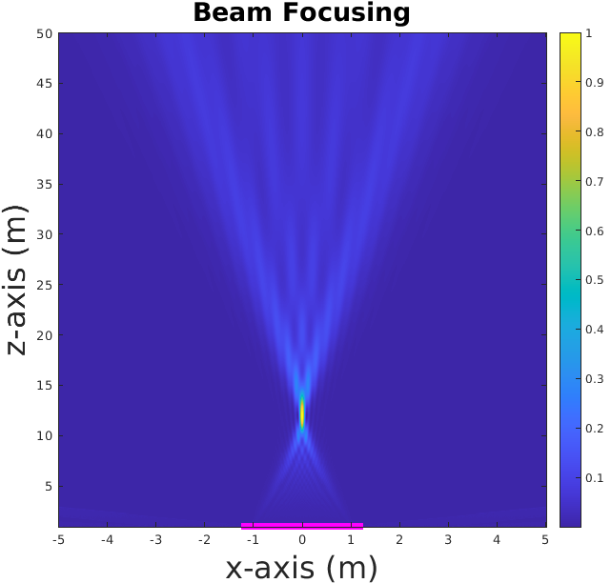
RIT
Near-field Beampatterns
What happens if the user is located in the Fresnel region?

Slide 12
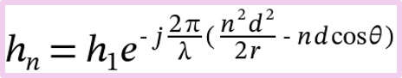
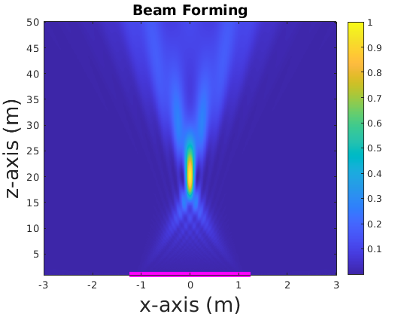
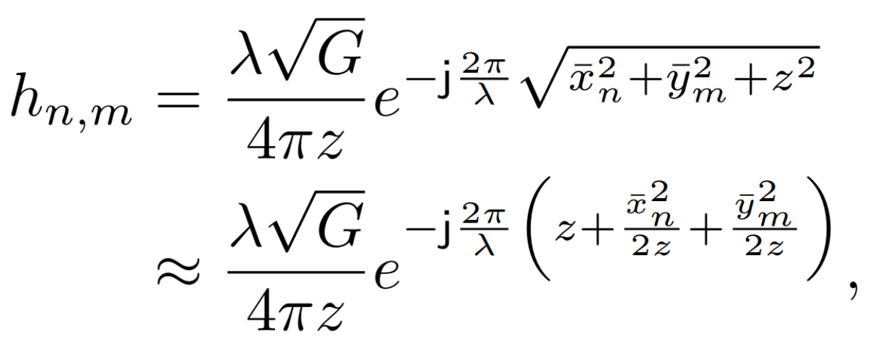
RIT
Beam Focusing
M = 250
F = 20 m
The gain is the same in the Far-Field and Near-Field

Slide 13
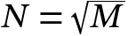
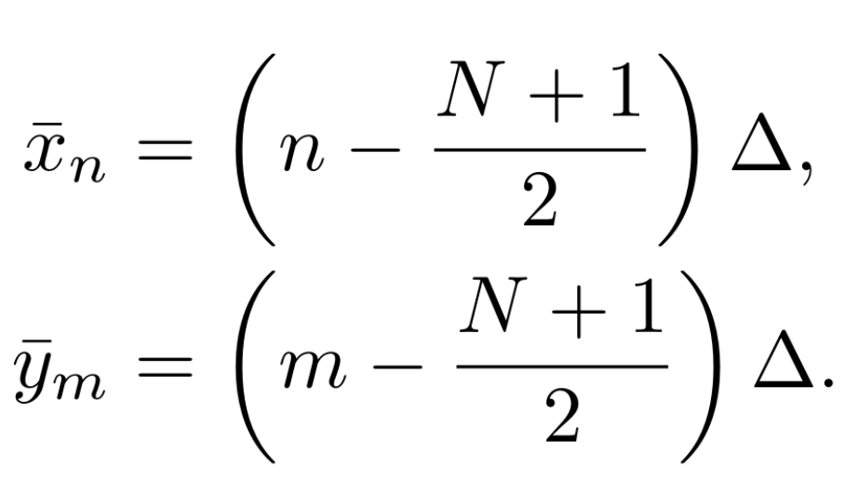
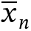
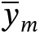
RIT
Beam Focusing in the Near-Field
A uniform squared array with M antenna
Taylor approximation
Björnson E, Chae CB, Heath Jr RW, Marzetta TL, Mezghani A, Sanguinetti L, Rusek F, Castellanos MR, Jun D, Demir ÖT. Towards 6G MIMO: Massive spatial multiplexing, dense arrays, and interplay between electromagnetics and processing. arXiv preprint arXiv:2401.02844. 2024 Jan 5.

Slide 14
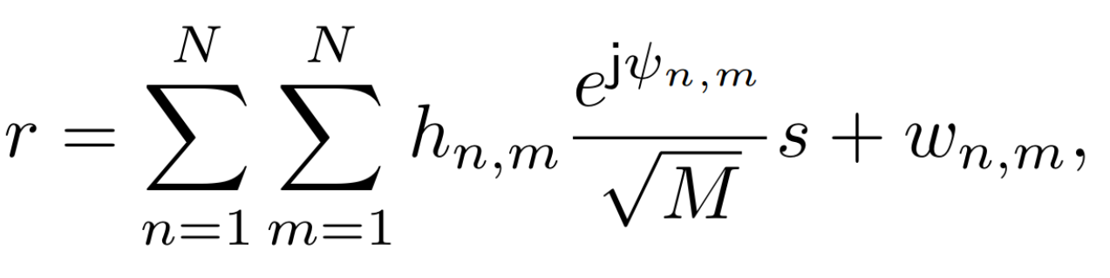
RIT
Beam Focusing in the Near-field
A uniform squared array with M antenna
Björnson E, Chae CB, Heath Jr RW, Marzetta TL, Mezghani A, Sanguinetti L, Rusek F, Castellanos MR, Jun D, Demir ÖT. Towards 6G MIMO: Massive spatial multiplexing, dense arrays, and interplay between electromagnetics and processing. arXiv preprint arXiv:2401.02844. 2024 Jan 5.

Slide 15
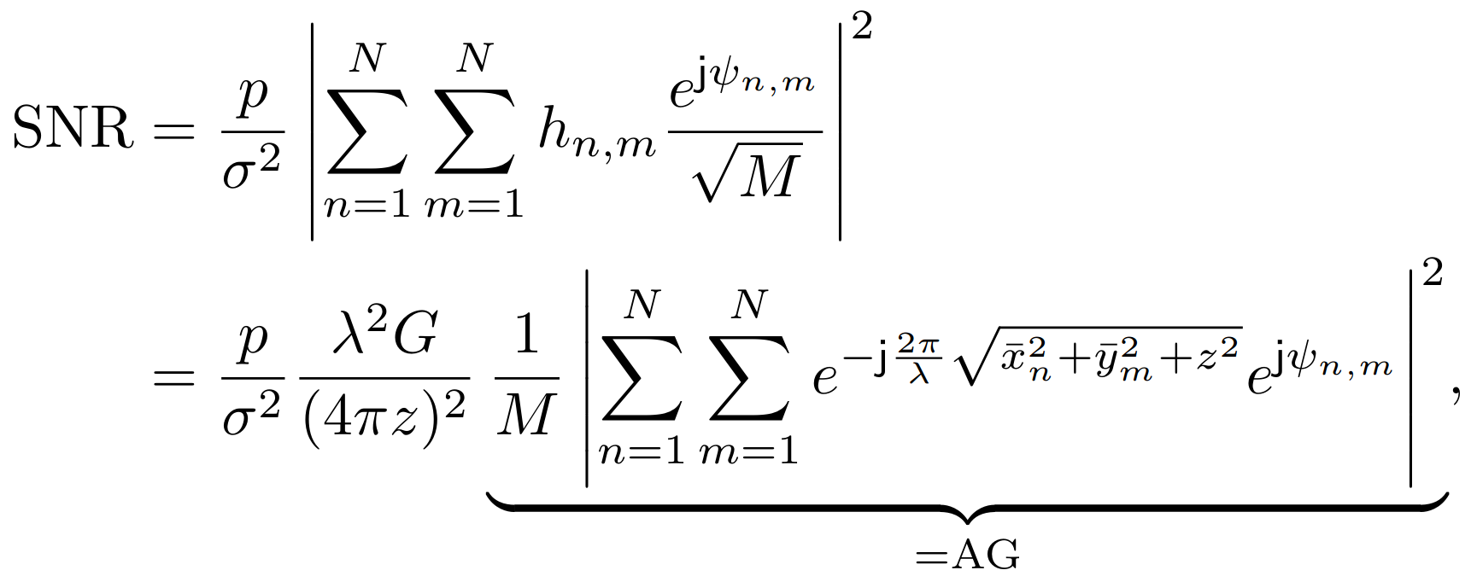
RIT
Beam Focusing in the Near-field
A uniform squared array with M antenna
Array Gain
Björnson E, Chae CB, Heath Jr RW, Marzetta TL, Mezghani A, Sanguinetti L, Rusek F, Castellanos MR, Jun D, Demir ÖT. Towards 6G MIMO: Massive spatial multiplexing, dense arrays, and interplay between electromagnetics and processing. arXiv preprint arXiv:2401.02844. 2024 Jan 5.

Slide 16
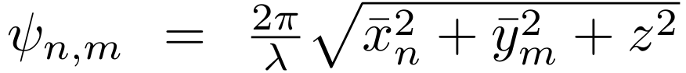
RIT
Beam Focusing in the Near-field
A uniform squared array with M antenna
Array Gain
Björnson E, Chae CB, Heath Jr RW, Marzetta TL, Mezghani A, Sanguinetti L, Rusek F, Castellanos MR, Jun D, Demir ÖT. Towards 6G MIMO: Massive spatial multiplexing, dense arrays, and interplay between electromagnetics and processing. arXiv preprint arXiv:2401.02844. 2024 Jan 5.

Slide 17
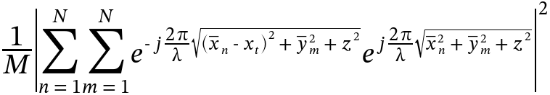
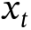
RIT
Beamwidth in the nearfield
Focus point
Array Gain
Focus point
Kosasih A, Demir ÖT, Björnson E. Achieving Beamfocusing via Two Separated Uniform Linear Arrays. arXiv preprint arXiv:2412.03232. 2024 Dec 4.

Slide 18
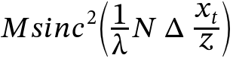
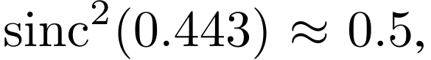
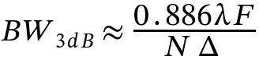
RIT
Beamwidth in the nearfield
Array Gain
Focus point
Kosasih A, Demir ÖT, Björnson E. Achieving Beamfocusing via Two Separated Uniform Linear Arrays. arXiv preprint arXiv:2412.03232. 2024 Dec 4.

Slide 19
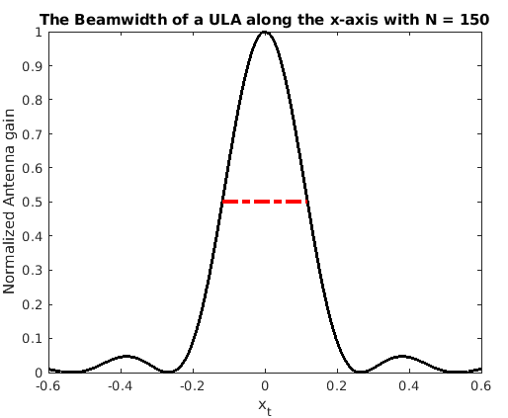
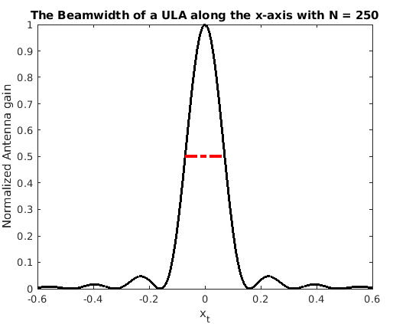
RIT
Beamwidth in the Near-field
M = 150
F = 20 m
BW3dB = 0.236 m
M = 250
F = 20 m
BW3dB = 0.141 m
Kosasih A, Demir ÖT, Björnson E. Achieving Beamfocusing via Two Separated Uniform Linear Arrays. arXiv preprint arXiv:2412.03232. 2024 Dec 4.

Slide 20
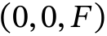
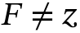
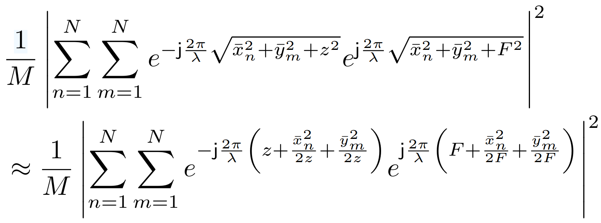
RIT
Beamdepth in the Near-field
Focus point
Array Gain
F
Björnson E, Chae CB, Heath Jr RW, Marzetta TL, Mezghani A, Sanguinetti L, Rusek F, Castellanos MR, Jun D, Demir ÖT. Towards 6G MIMO: Massive spatial multiplexing, dense arrays, and interplay between electromagnetics and processing. arXiv preprint arXiv:2401.02844. 2024 Jan 5.
Ramezani P, Björnson E. Near-field beamforming and multiplexing using extremely large aperture arrays. In Fundamentals of 6G Communications and Networking 2023 Jul 10 (pp. 317-349).

Slide 21
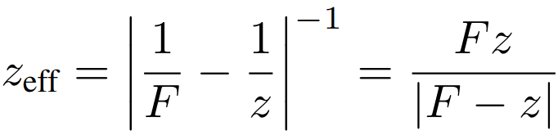
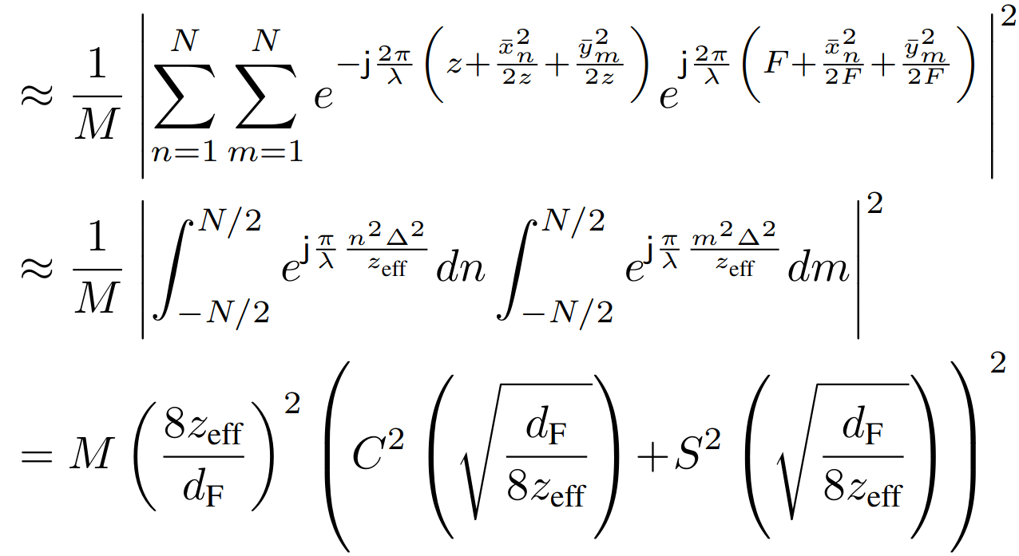
RIT
Beamdepth in the Near-field
Array Gain
F
Ramezani P, Björnson E. Near-field beamforming and multiplexing using extremely large aperture arrays. In Fundamentals of 6G Communications and Networking 2023 Jul 10 (pp. 317-349).
Polk C. Optical Fresnel-zone gain of a rectangular aperture. IRE Transactions on Antennas and Propagation. 1956 Jan;4(1):65-9.

Slide 22
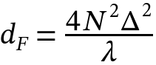
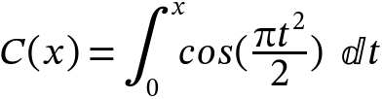
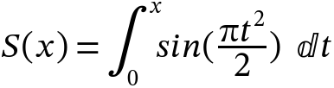
RIT
Beamdepth in the Near-field
Fresnel integrals
F
Björnson E, Chae CB, Heath Jr RW, Marzetta TL, Mezghani A, Sanguinetti L, Rusek F, Castellanos MR, Jun D, Demir ÖT. Towards 6G MIMO: Massive spatial multiplexing, dense arrays, and interplay between electromagnetics and processing. arXiv preprint arXiv:2401.02844. 2024 Jan 5.

Slide 23
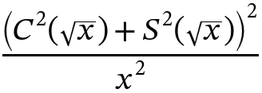
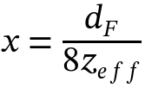
RIT
Beamdepth in the Near-field
F
Björnson E, Chae CB, Heath Jr RW, Marzetta TL, Mezghani A, Sanguinetti L, Rusek F, Castellanos MR, Jun D, Demir ÖT. Towards 6G MIMO: Massive spatial multiplexing, dense arrays, and interplay between electromagnetics and processing. arXiv preprint arXiv:2401.02844. 2024 Jan 5.

Slide 24

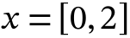
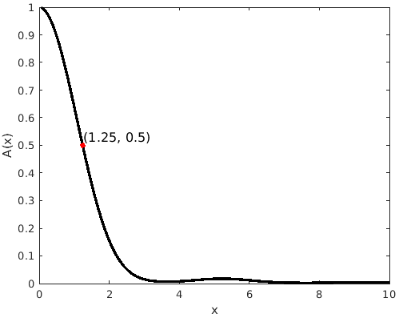
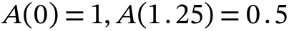
RIT
Beamdepth in the Near-field
Decreasing function for
Notes:
Plot the function in matlab and show the point in the figure

Slide 25
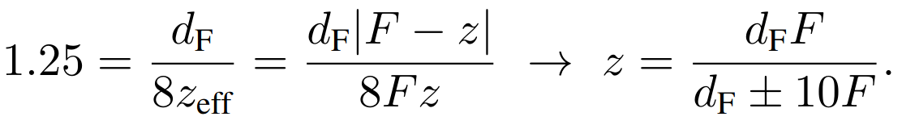


RIT
Beamdepth in the Near-field
Decreasing function for
Björnson E, Chae CB, Heath Jr RW, Marzetta TL, Mezghani A, Sanguinetti L, Rusek F, Castellanos MR, Jun D, Demir ÖT. Towards 6G MIMO: Massive spatial multiplexing, dense arrays, and interplay between electromagnetics and processing. arXiv preprint arXiv:2401.02844. 2024 Jan 5.

Slide 26


RIT
Beamdepth in the Near-field

Slide 27


RIT
Beamdepth in the Near-field
M = 150
F = 20 m
BW = 0.236 m
BD = 39.72m
M = 250
F = 20 m
BW = 0.141 m
BD = 9.26m
M = 500
F = 20 m
BW =0.0708m
BD= 3.226m

Slide 28









RIT
Nearfield spatial multiplexing
Far-field
Nearfield
Impact of the wavelength
Fixed array size:
Fixed number of elements:

Slide 29



RIT
Nearfield spatial multiplexing
Smaller focus area in Nearfield, both in depth and width.
Reduce interference between concurrent signal transmission.
Massive spatial multiplexing
Ramezani P, Kosasih A, Irshad A, Björnson E. Exploiting the depth and angular domains for massive near-field spatial multiplexing. IEEE BITS the Information Theory Magazine. 2023 Oct 6;3(1):14-26.

Slide 30




RIT
Bessel Beam
A long column of constructive interference can be seen along the z-axis.
As the wave propagates, the beam profile remains invariant.
Headland D, Monnai Y, Abbott D, Fumeaux C, Withayachumnankul W. Tutorial: Terahertz beamforming, from concepts to realizations. Apl Photonics. 2018 May 1;3(5).

Slide 31

RIT
Bessel Beam
Headland D, Monnai Y, Abbott D, Fumeaux C, Withayachumnankul W. Tutorial: Terahertz beamforming, from concepts to realizations. Apl Photonics. 2018 May 1;3(5).

Slide 32



RIT
Bessel Beam
Bessel beams are self-healing.
Bessel beam - Wikipedia
A. Singh et al., "Wavefront Engineering: Realizing Efficient Terahertz Band Communications in 6G and Beyond," in IEEE Wireless Communications, vol. 31, no. 3, pp. 133-139, June 2024.

Slide 33

RIT
Curved Beam
Follow arbitrary curved trajectories​
Solve challenges associated to blockage.
Trajectory
Result Beam
Guerboukha H, Zhao B, Fang Z, Knightly E, Mittleman DM. Curving THz Beams in the Near Field: A Framework to Compute Link Budgets. In2024 18th European Conference on Antennas and Propagation (EuCAP) 2024 Mar 17 (pp. 1-5). IEEE.

Slide 34

RIT
Bessel and Curved Beam

Slide 35

RIT
Will Near-Field Effects Appear in 6G?
Example :
0.5×0.5, 3 GHz = 1 m
1×1 m, 15 GHz = 20m
1×1 m, 30 GHz = 40 m
We need extremely large antenna array or very high frequency
Björnson E, Kara F, Kolomvakis N, Kosasih A, Ramezani P, Salman MB. Enabling 6G performance in the upper mid-band through gigantic MIMO. arXiv preprint arXiv:2407.05630. 2024 Jul.

Slide 36

Mini Matlab Project
RIT
ULA2
ULA1

Slide 37

RIT
National Radio Dynamic Zones (SII-NRDZ)
Allows radio waves to transmit freely.
Advanced technologies for spectrum sharing and coexistence.
What is the Dynamic Zone?​
Spectrum is a limited resource.​
Traditional methods are insufficient.​
Why It Matters
https://www.cs.albany.edu/nrdz-ra/
https://new.nsf.gov/funding/opportunities/sii-nrdz-spectrum-innovation-initiative-national-radio-dynamic-zones/505990/nsf22-579

Slide 38


RIT
Dynamic Zone in Action: Hat Creek Radio Observatory (HCRO)
San Francisco, California
Location:
Key Objectives:
RF Baseline Surveys (RFBS)
Exploring Spectrum Sharing Approaches
radio astronomy and satellites
https://lh3.googleusercontent.com/p/AF1QipPoNhQhKOqbjJdZNW2tIXe35B-OqKV74wtsLDQf=s680-w680-h510
https://www.colorado.edu/lab/wirg/research/spectrum-sharing/nsf-sii-nrdz-hcro-nrdz-field-deployment
https://www.youtube.com/watch?v=se9halsveGI

Slide 39

RIT
How to detect aliens' signals?
NASA's Project Cyclops in 1971
Detect signals traveling up to 1000 light-years
Absorbtion
Noise
Distinguishable from natural sources
Microwaves
1 mm – 1 m
https://en.wikipedia.org/wiki/Water_hole_(radio)
https://en.wikipedia.org/wiki/Project_Cyclops
https://www.seti.net/NewToSETINet/aboutSETINet/about.php
https://www.seti.net/indepth/waterhole/waterhole.php

Slide 40






RIT
Waterhole
There is a magical narrow gate in Microwaves
Water hole
18cm-21cm
https://en.wikipedia.org/wiki/Hydrogen_line
https://en.wikipedia.org/wiki/Hydroxyl_radical
The 242 MHz area, between the hydrogen line (1420 MHz) and the hydroxyl lines (1662MHz), are the quietest part of the spectrum
https://en.wikipedia.org/wiki/Water_hole_(radio)
https://en.wikipedia.org/wiki/Project_Cyclops

Slide 41

RIT
Waterhole
Waterhole
18cm-21cm
1420-1662 MHz
Oliver:
“What more poetic place could there be for water-based life to seek its kind than the age-old meeting place for all species: the water hole”
https://www.seti.net/indepth/waterhole/waterhole.php

